Slide 1
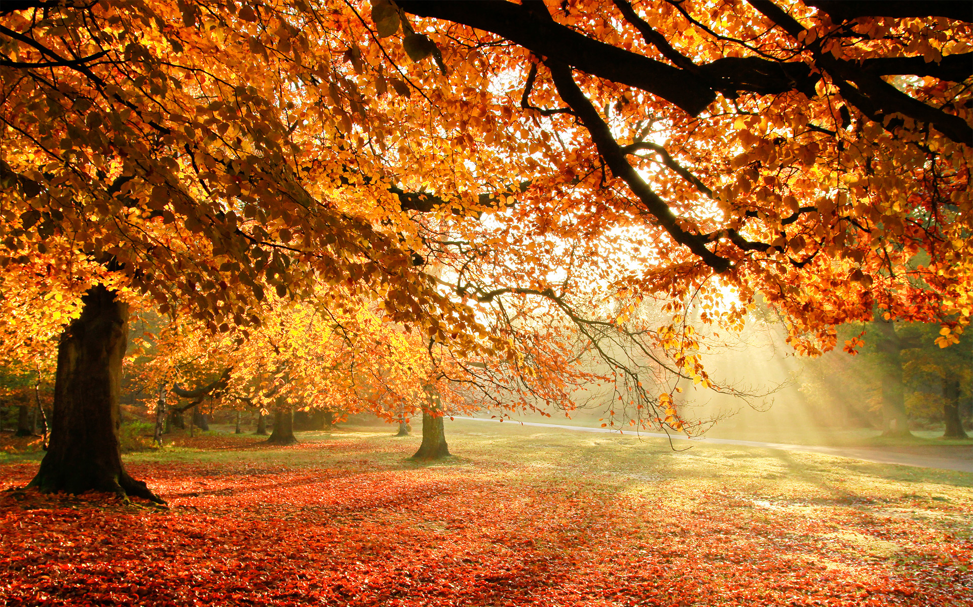
English
Leon and the Place Between – Descriptive writing
Little People Big Dreams Marcus Rashford – biography
The Croods: The Novel – Recount
Snow White in New York – Newspaper Report
The Grinch Who Stole Christmas – Poetry
History
Enquiry : To understand the chronology of Early Man from Stone Age to Iron Age
Investigate the chronological order of Early Man
Explore the key changes in society from hunter gatherers to building communities
Create information related to history by evaluating different sources
Geography
Enquiry : To explain how the movement of Earth’s crust causes natural disasters
Investigate how plate tectonics create natural disasters
Explore natural events such as volcanoes and earthquakes
Create information texts
Grammar
Writing Techniques : similes, rhetorical questions, verbs, personification
Sentence Structure: power of three, fronted adverbials, relative clauses, subordinating conjunctions
Punctuation: ellipsis, semi colon, dashes, inverted commas, colon
Autumn Term 2026
Woodpecker Class
Science
Enquiry : To create a range of circuits that use different components
Investigate the uses of electricity
Explore ideas and test and evaluate them
Create working circuits with a purpose
British Values
Democracy
The Rule of Law
Christian Values
Friendship
Justice
Computing
Enquiry : To recognise unacceptable behaviour online and identify a range of ways to report concerns.
DT
Enquiry : To investigate the use of electrical mechanisms and create an electrical product
Maths
Place Value: roman numerals, rounding, partitioning whole numbers
Addition and Subtraction : column addition and subtraction with exchange
Multiplication and division : 1-12 times tables, multiply and divide by 10,100,1000
Area (Year 4 only)
Fractions (Year 5/6 only)
PSHE
Me and My Relationships and Valuing Difference
Children will develop the skills needed to build positive friendships. They will explore different emotions and learn how to communicate respectfully. Children will learn to celebrate diversity and understand that everyone is unique and should be treated with respect.

