Slide 2
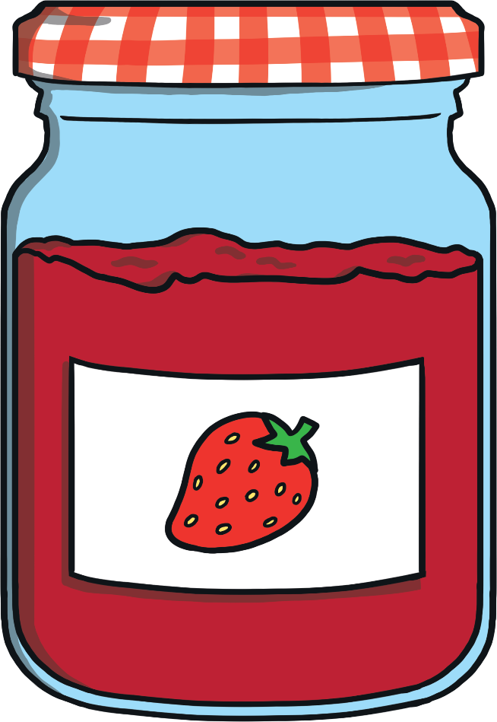



jam
jam
?
Next

Slide 3
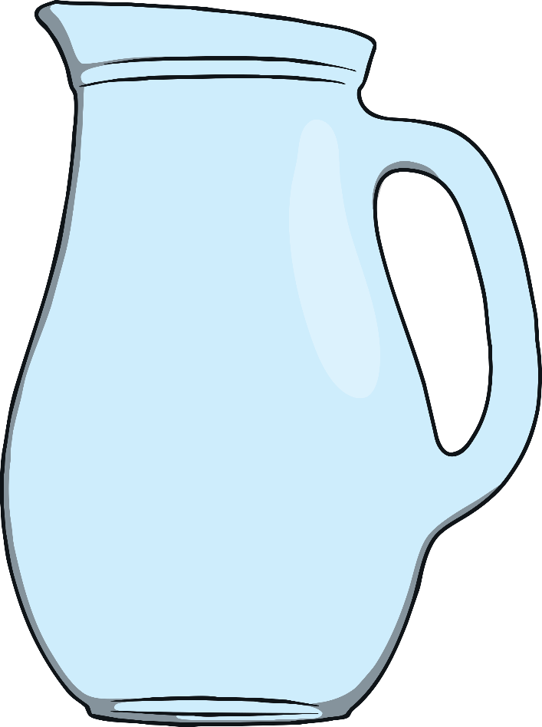
jug
jug
?
Next

Slide 4
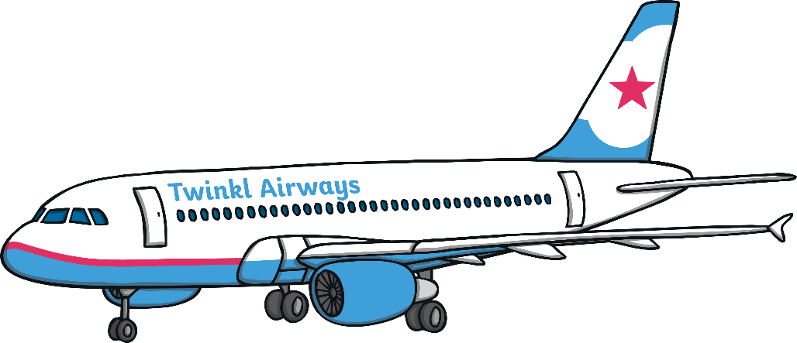
jet
jet
?
Next

Slide 5

vet
vet
?
Next

Slide 6
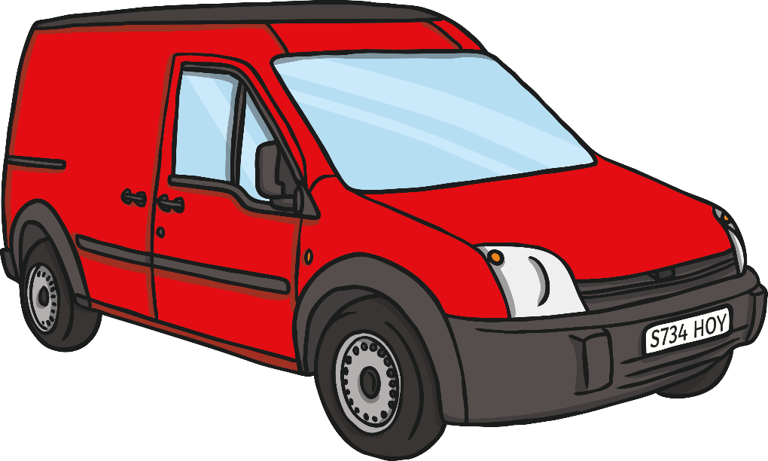
van
van
?
Next

Slide 7

wig
wig
?
Next

Slide 8
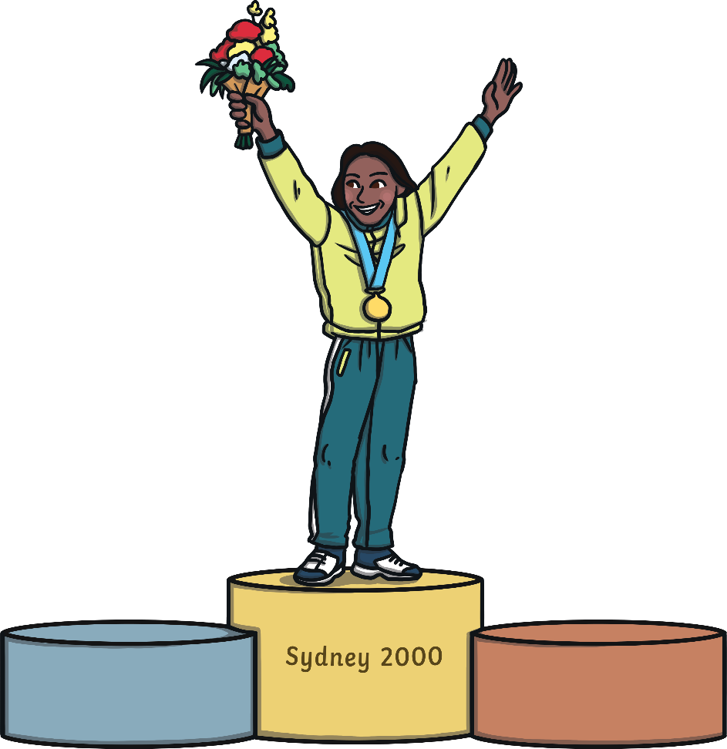
win
win
?
Next

Slide 9
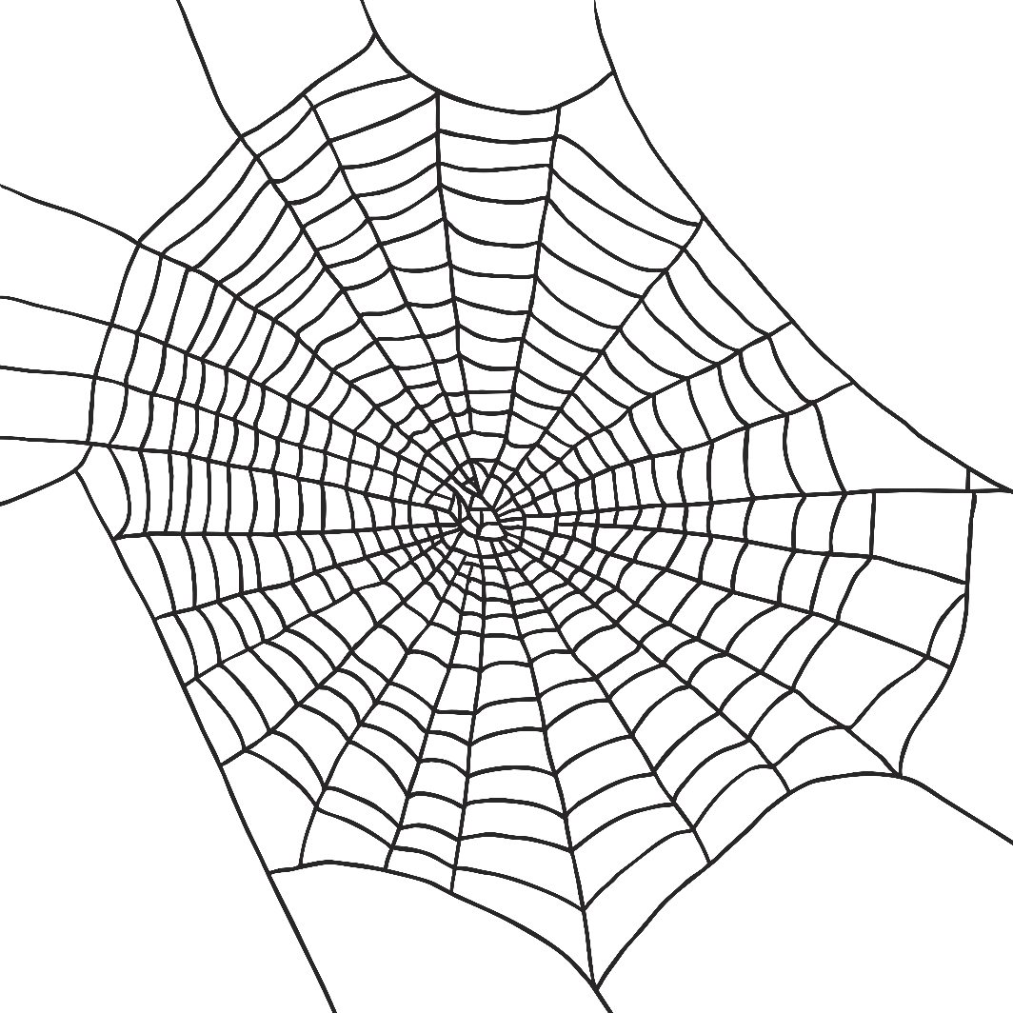
cobweb
cobweb
?
Next

Slide 10

box
box
?
Next

Slide 11
six
six
6
?
Next

Slide 12
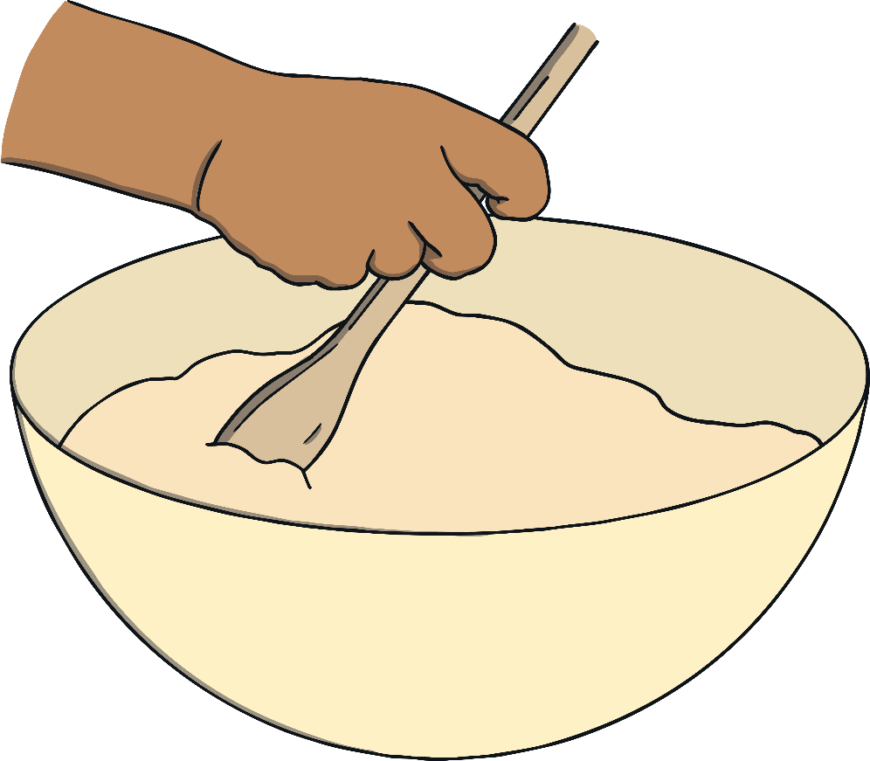
mix
mix
?
Next

Slide 13
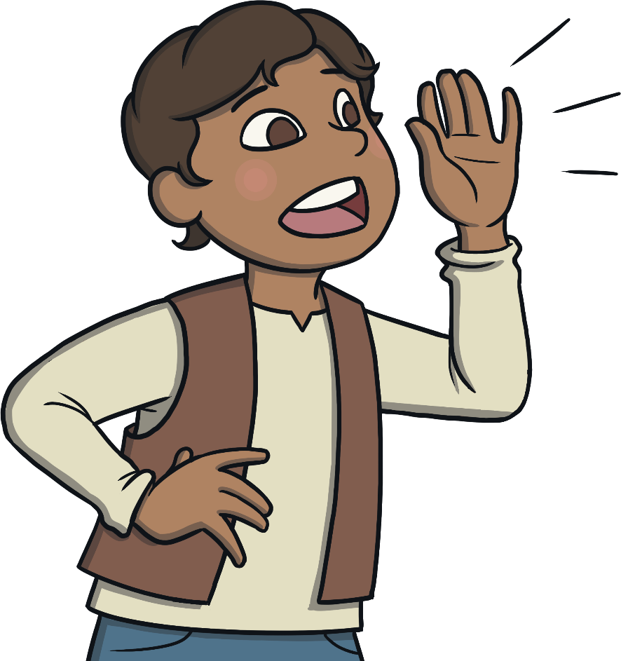
yell
yell
?
Next

Slide 14
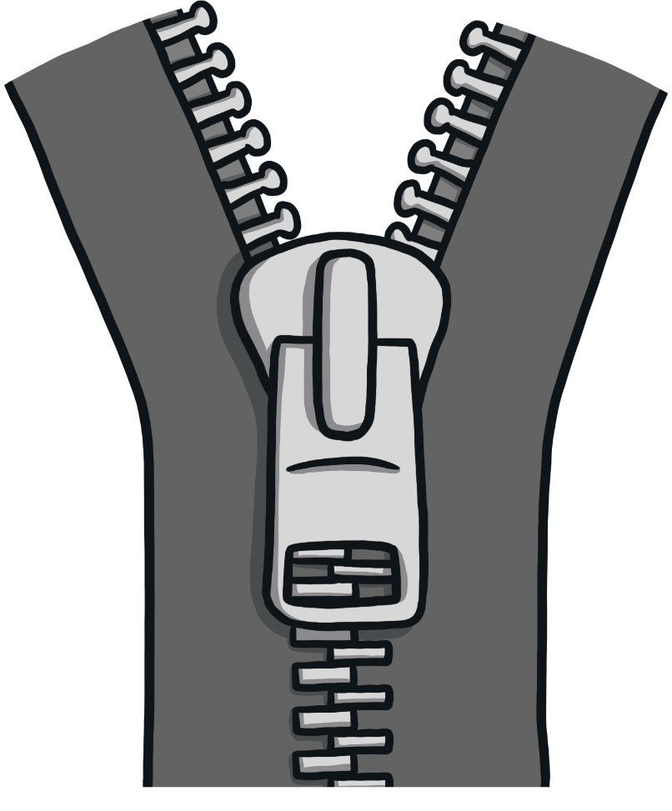
zip
zip
?
Next

Slide 15
zap
zap
?
Next

Slide 16

zigzag
zigzag
?
Next

Slide 17
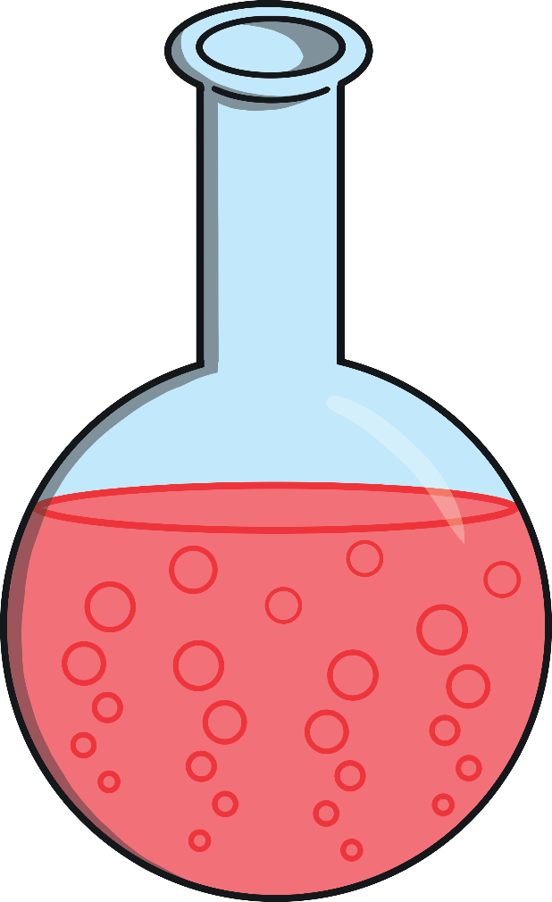
fizz
fizz
?
Next

Slide 18
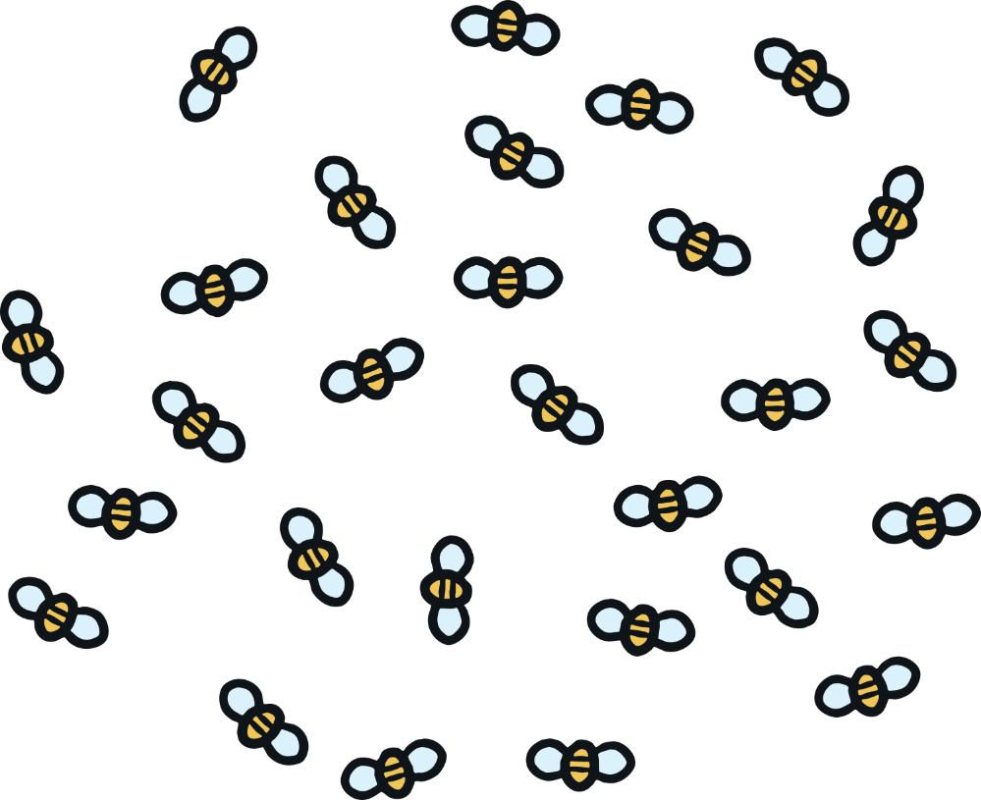
buzz
buzz
?
Next

Slide 19
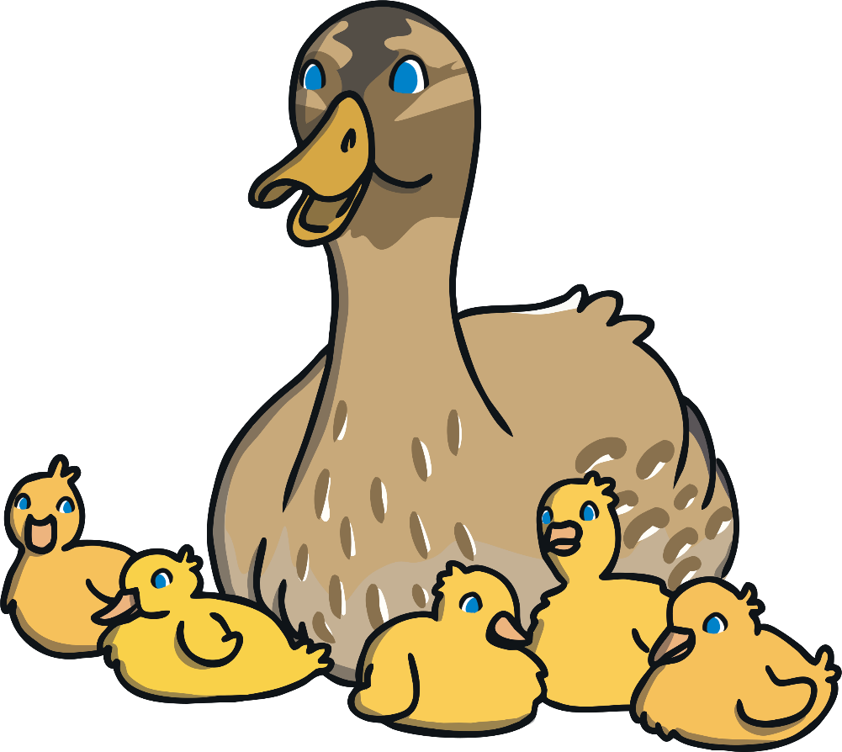
quack
quack
?
Next

Slide 20
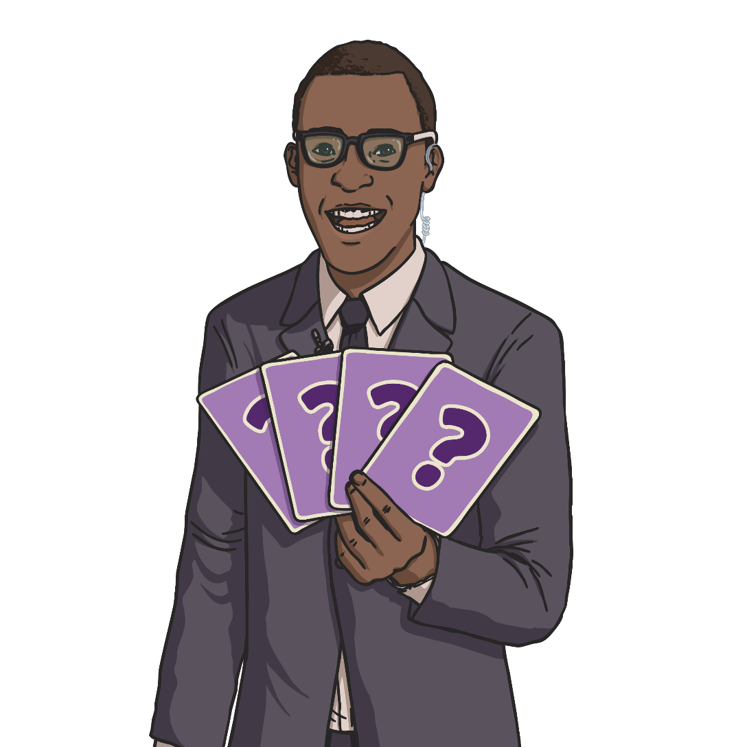
quiz
quiz
?
Next

Slide 21
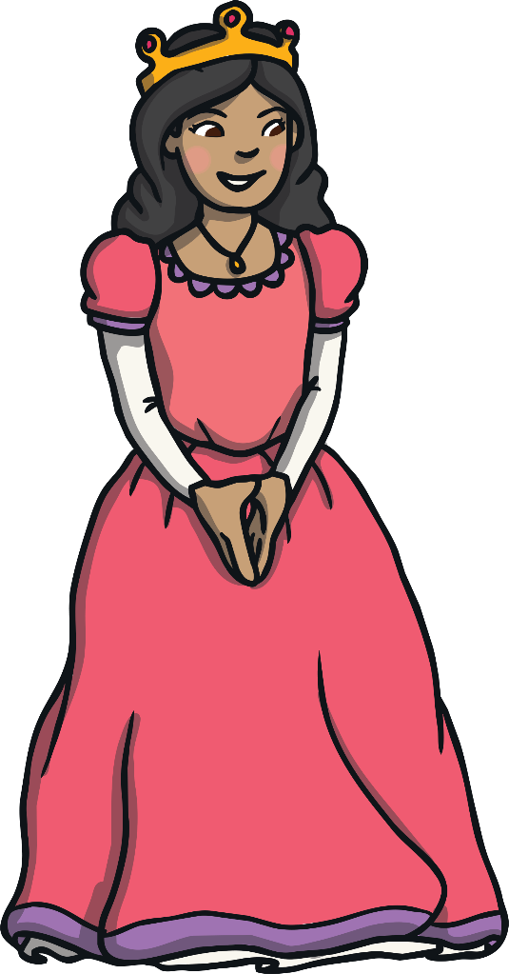
queen
queen
?
Next

Slide 22
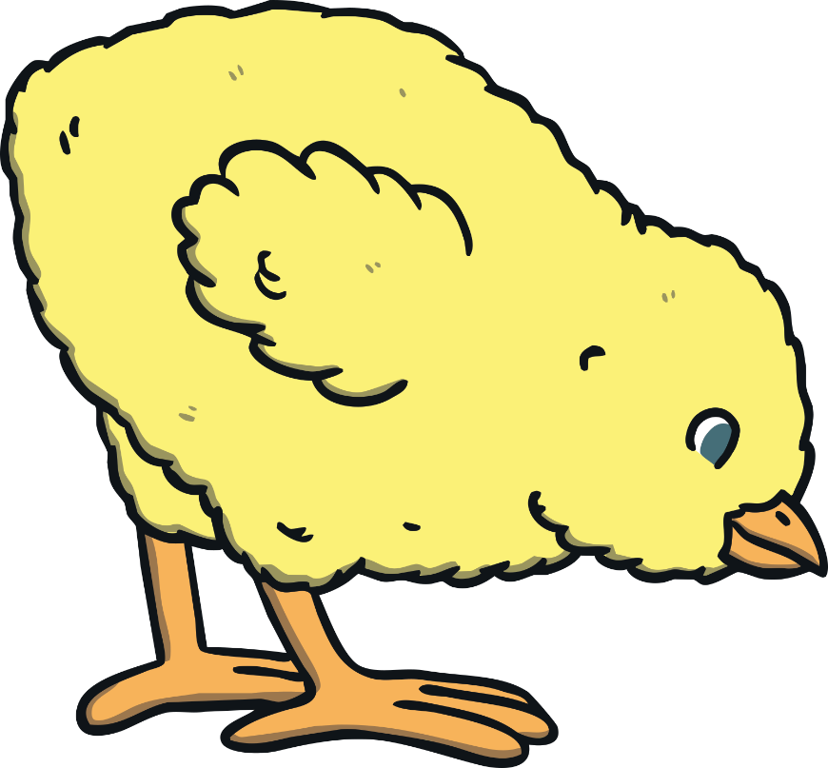
chick
chick
?
Next

Slide 23
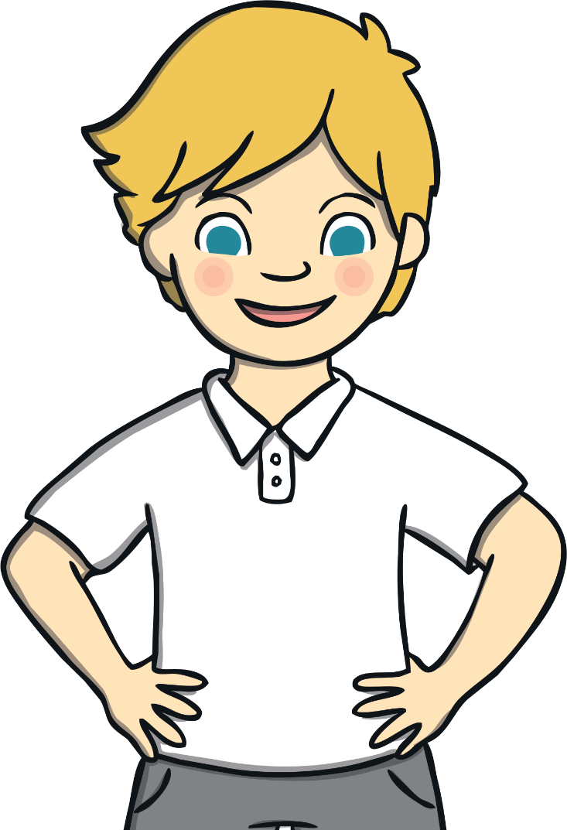

chin
chin
?
Next

Slide 24
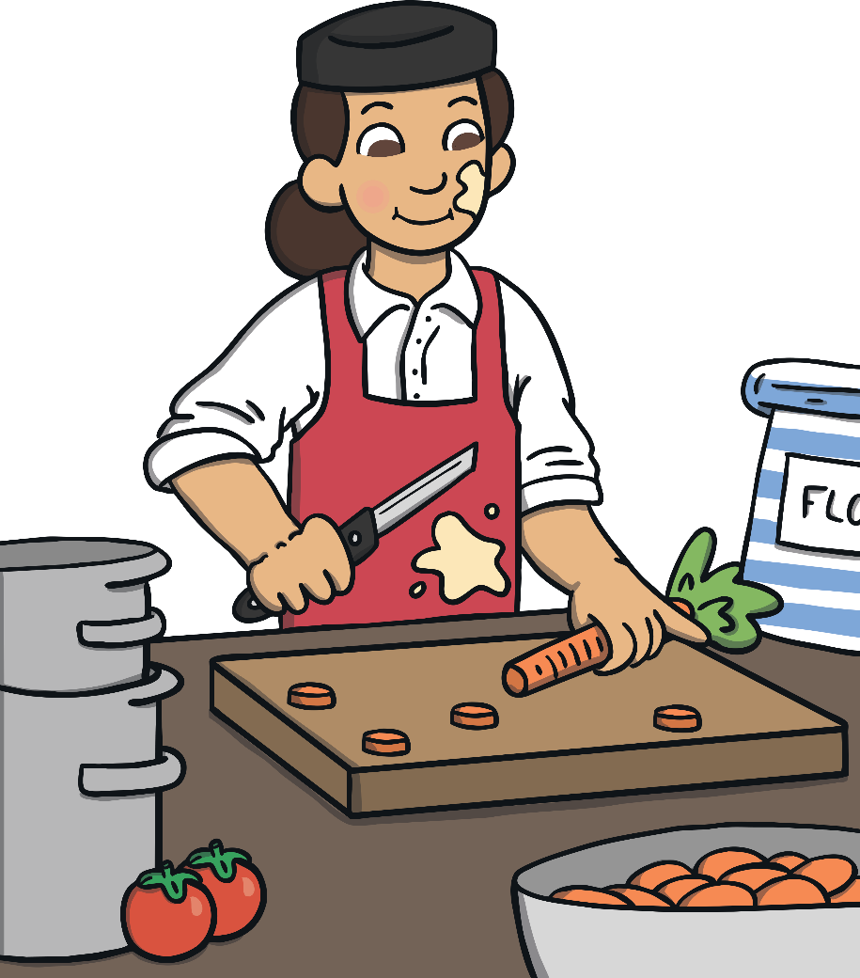
chop
chop
?
Next

Slide 25
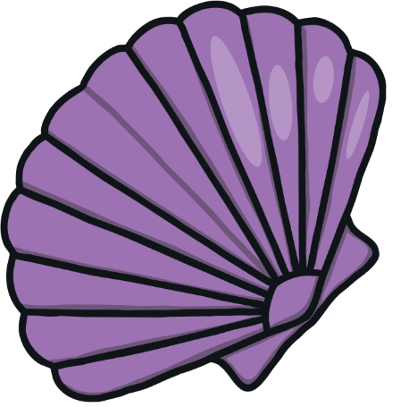
shell
shell
?
Next

Slide 26
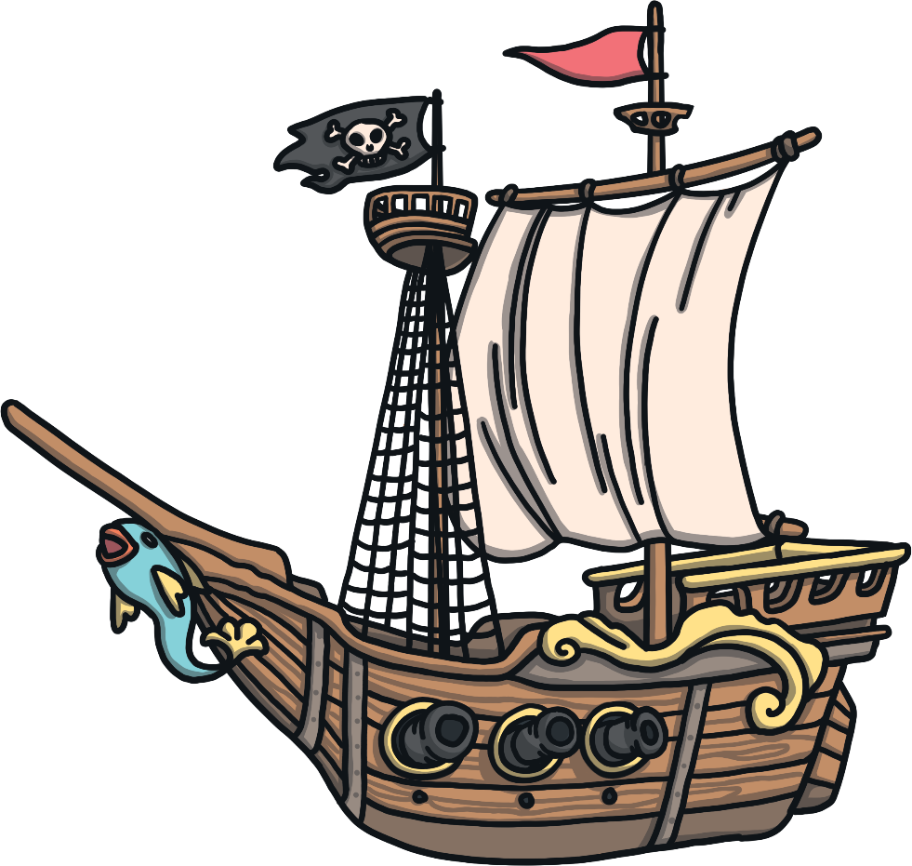
ship
ship
?
Next

Slide 27
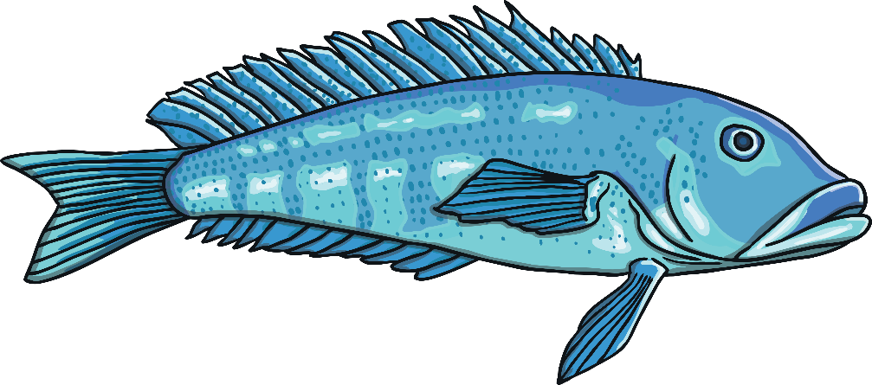
fish
fish
?
Next

Slide 28
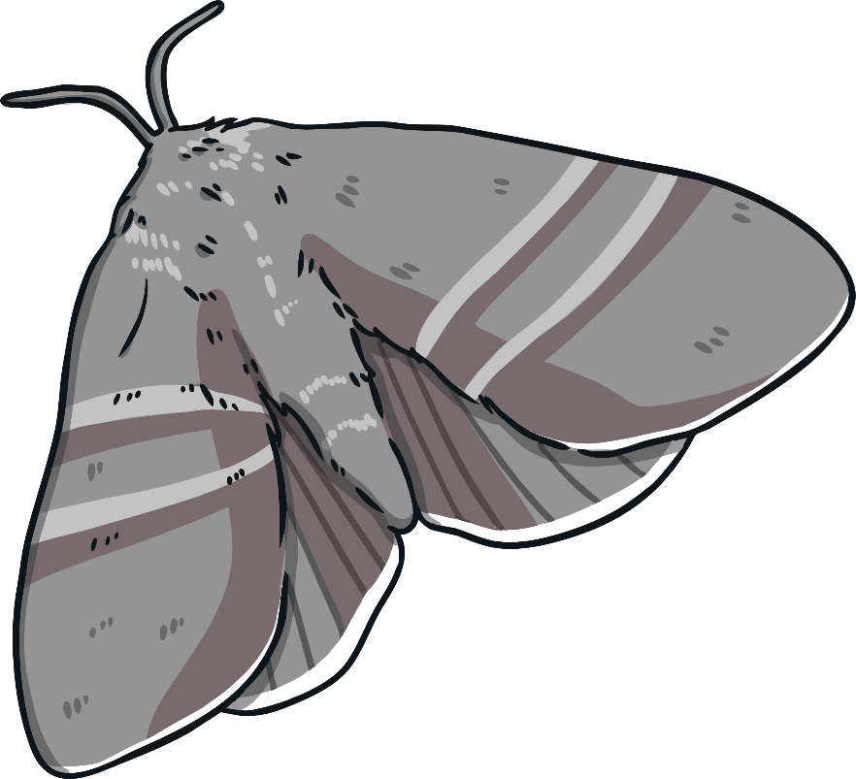
moth
moth
?
Next

Slide 29
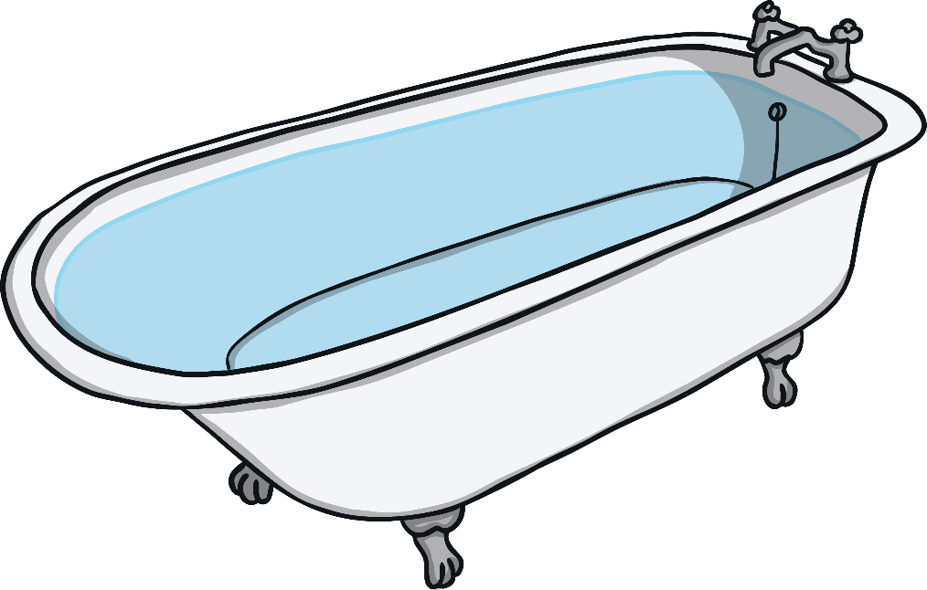
bath
bath
?
Next

Slide 30

path
path
?
Next

Slide 31
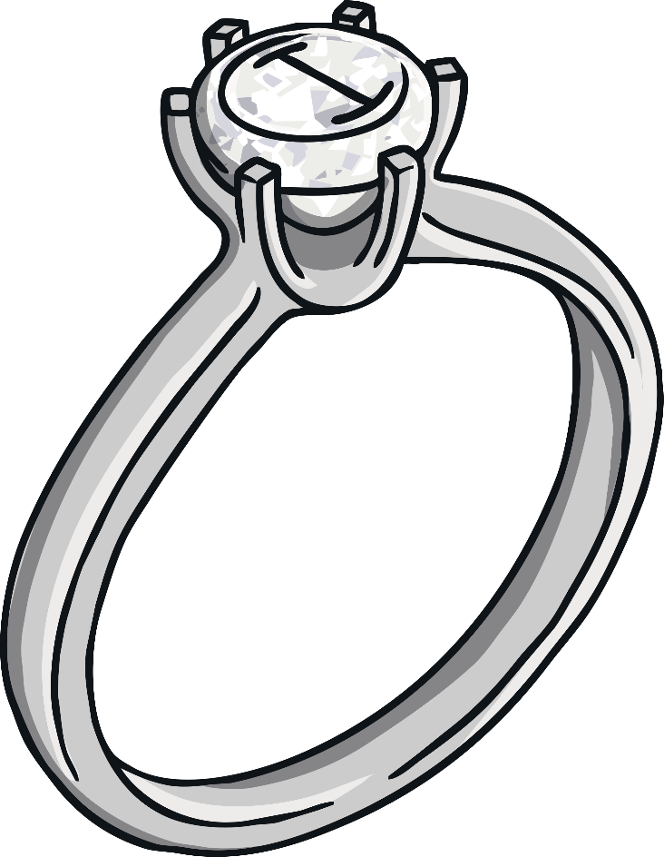
ring
ring
?
Next

Slide 32
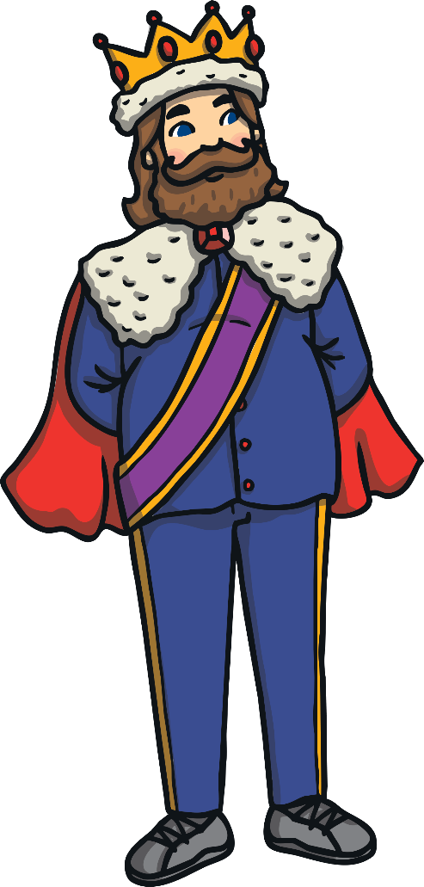
king
king
?
Next

Slide 33
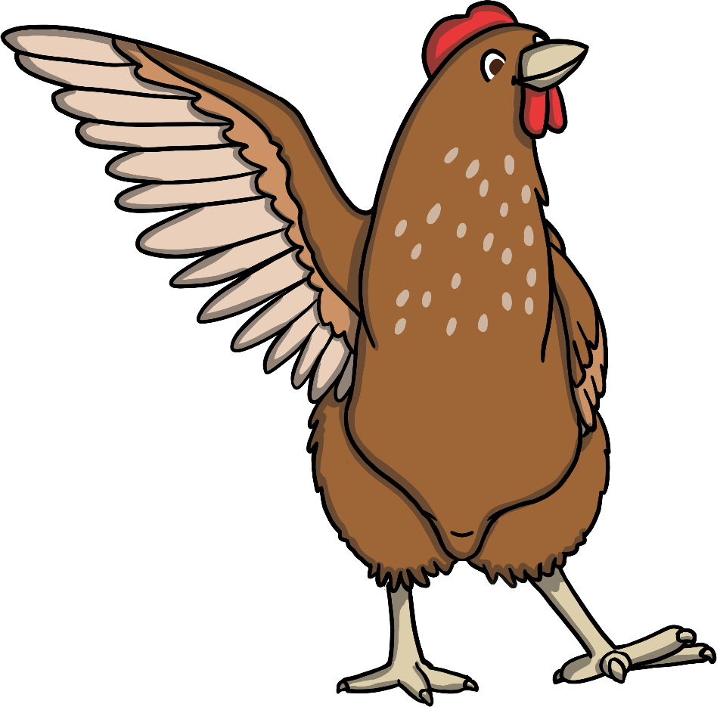

wing
wing
?
Next

Slide 34
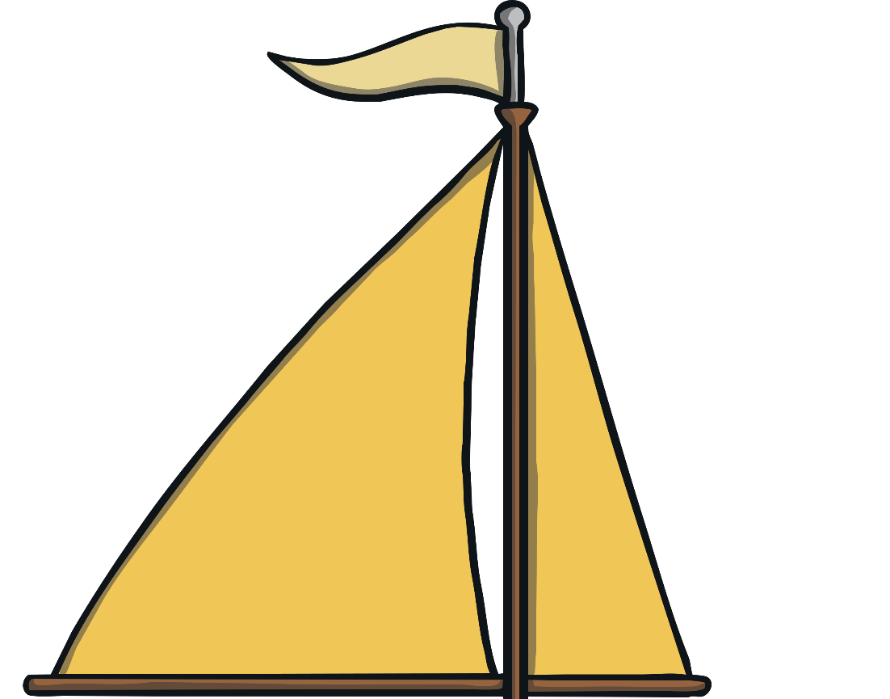
sail
sail
?
Next

Slide 35


tail
tail
?
Next

Slide 36

rain
rain
?
Next

Slide 37
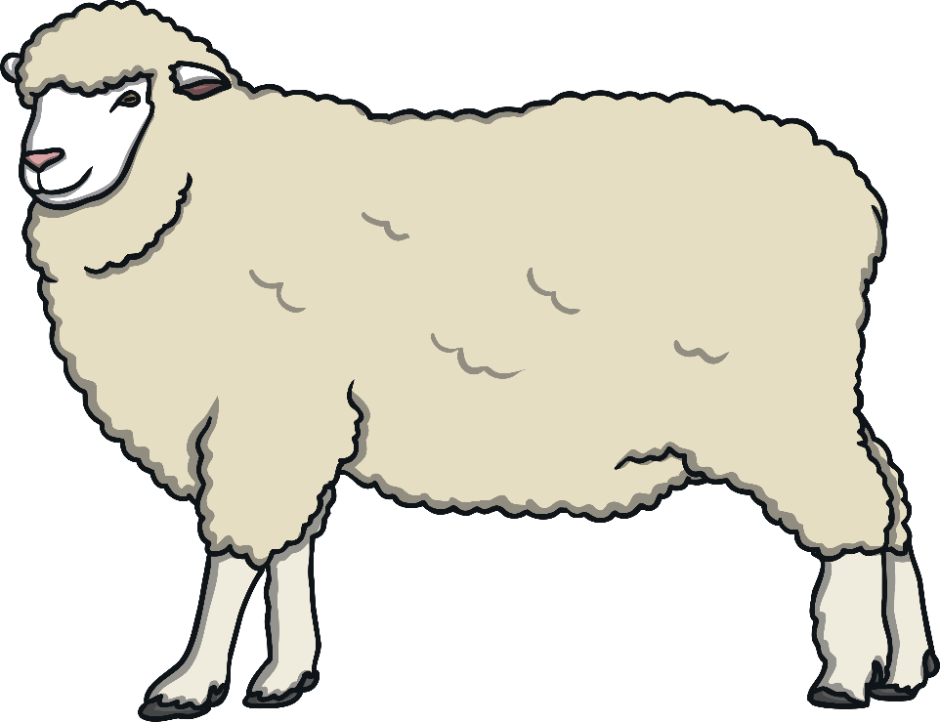
sheep
sheep
?
Next

Slide 38
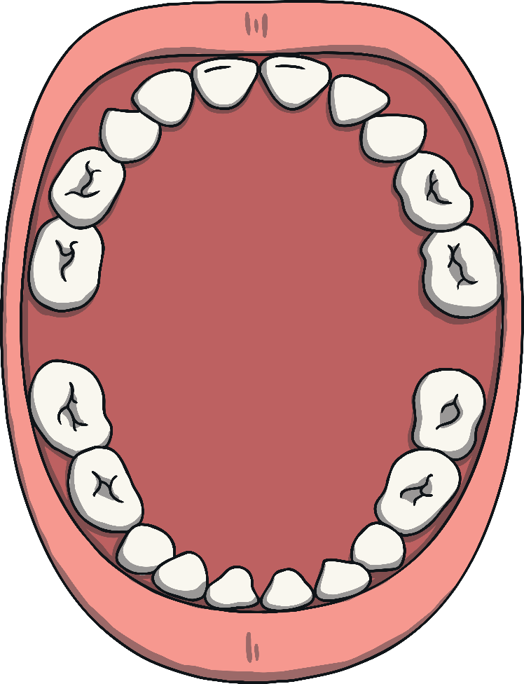
teeth
teeth
?
Next

Slide 39

light
light
?
Next

Slide 40
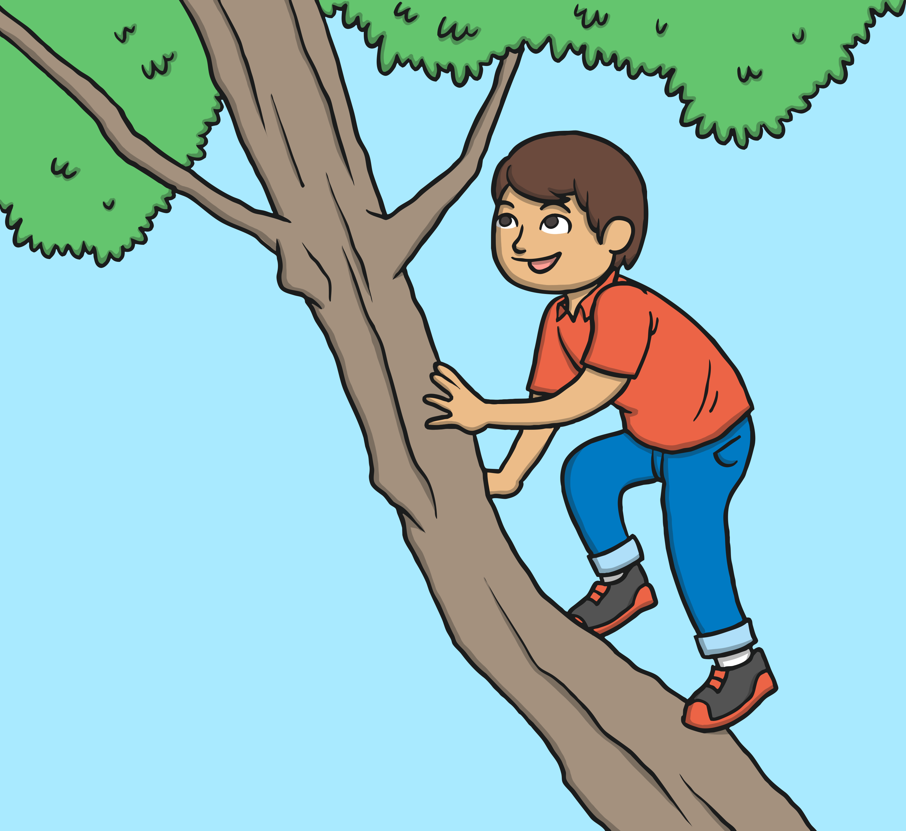
high
high
?
Next

Slide 41
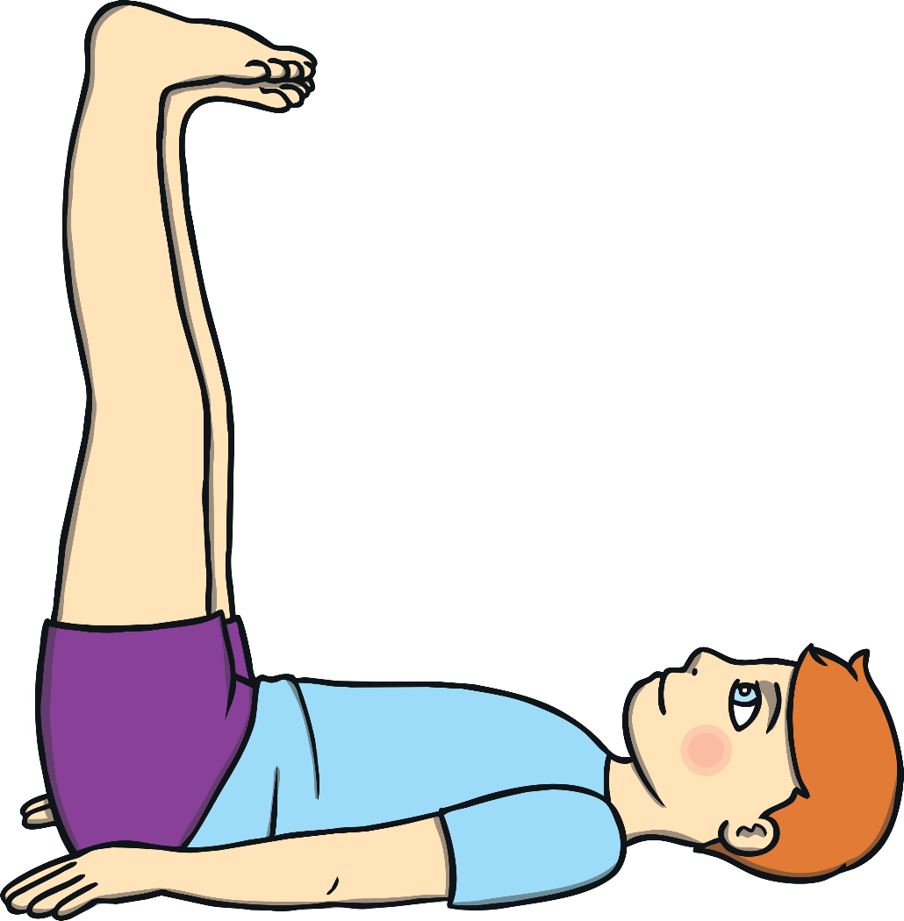
thigh
thigh
?
Next

Slide 42
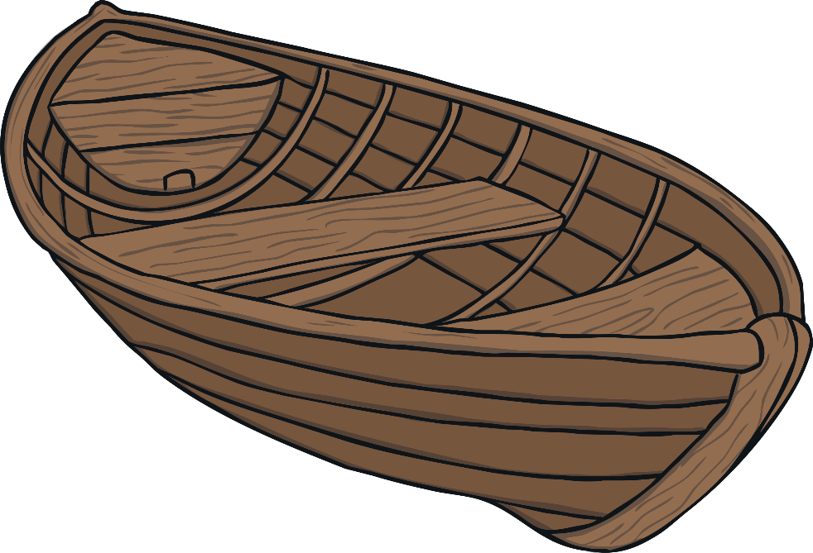
boat
boat
?
Next

Slide 43
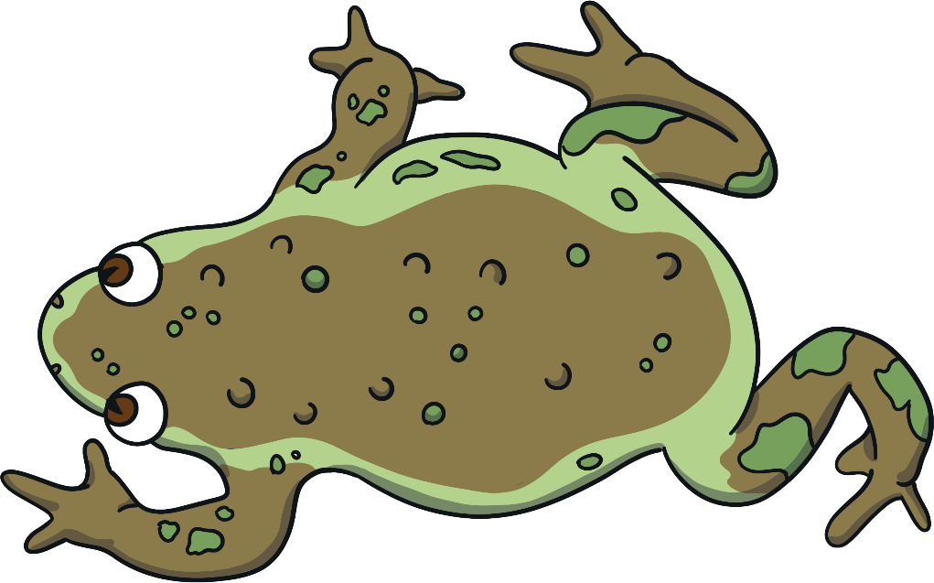
toad
toad
?
Next

Slide 44

coat
coat
?
Next

Slide 45
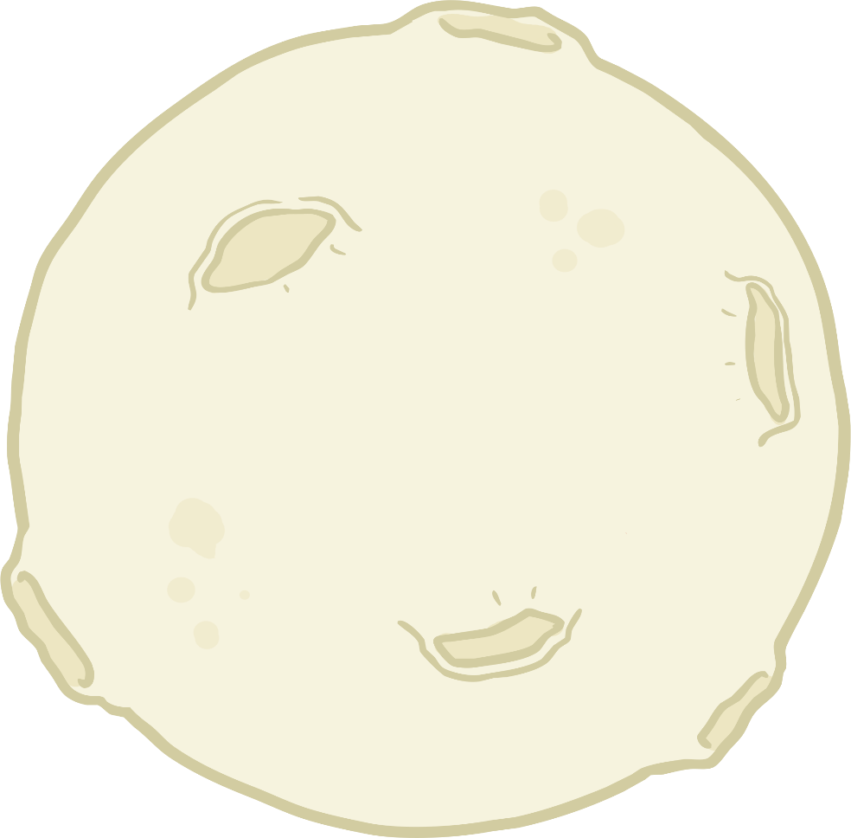
moon
moon
?
Next

Slide 46

zoo
zoo
?
Next

Slide 47
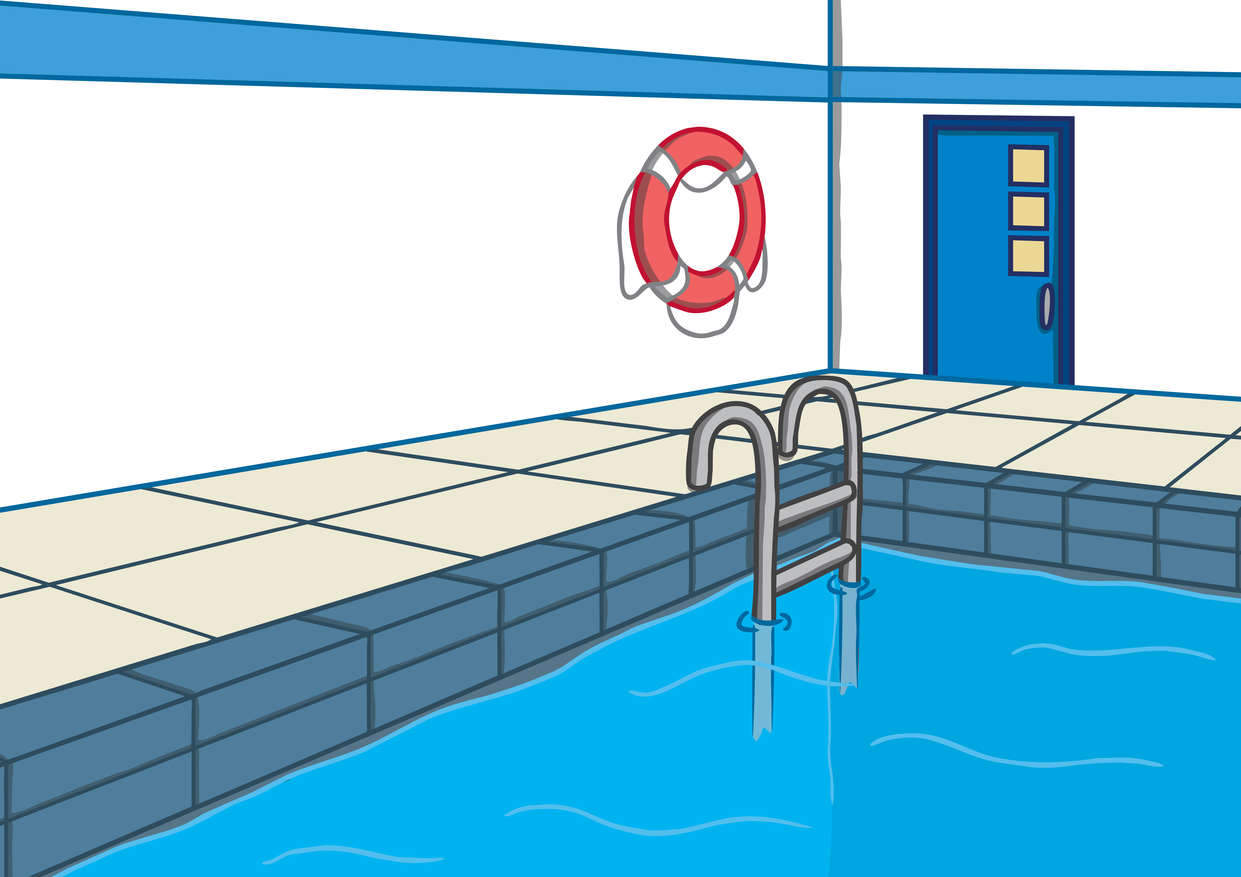
pool
pool
?
Next

Slide 48

book
book
?
Next

Slide 49
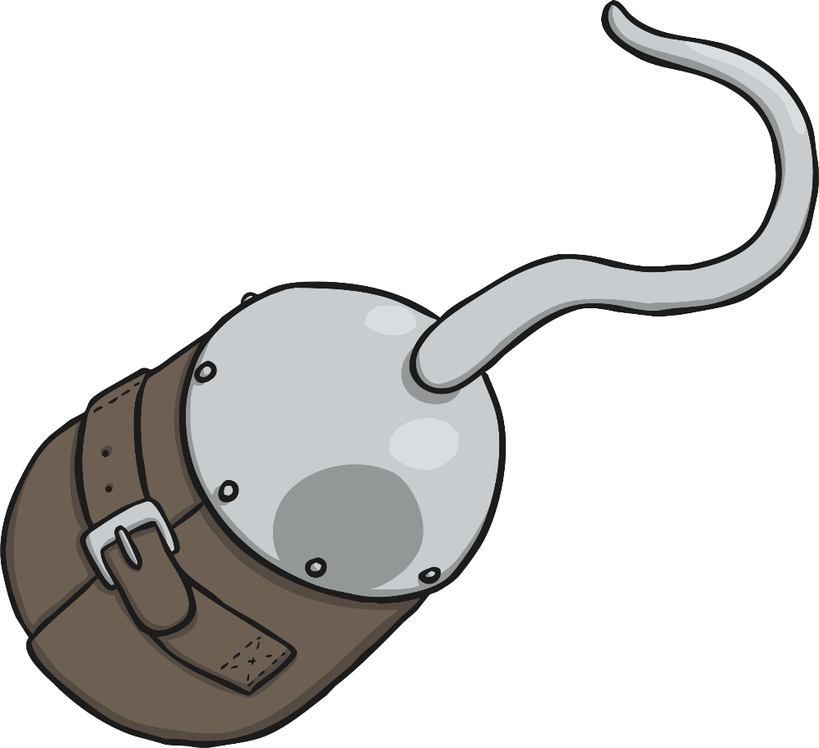
hook
hook
?
Next

Slide 50

foot
foot
?
Next

Slide 51
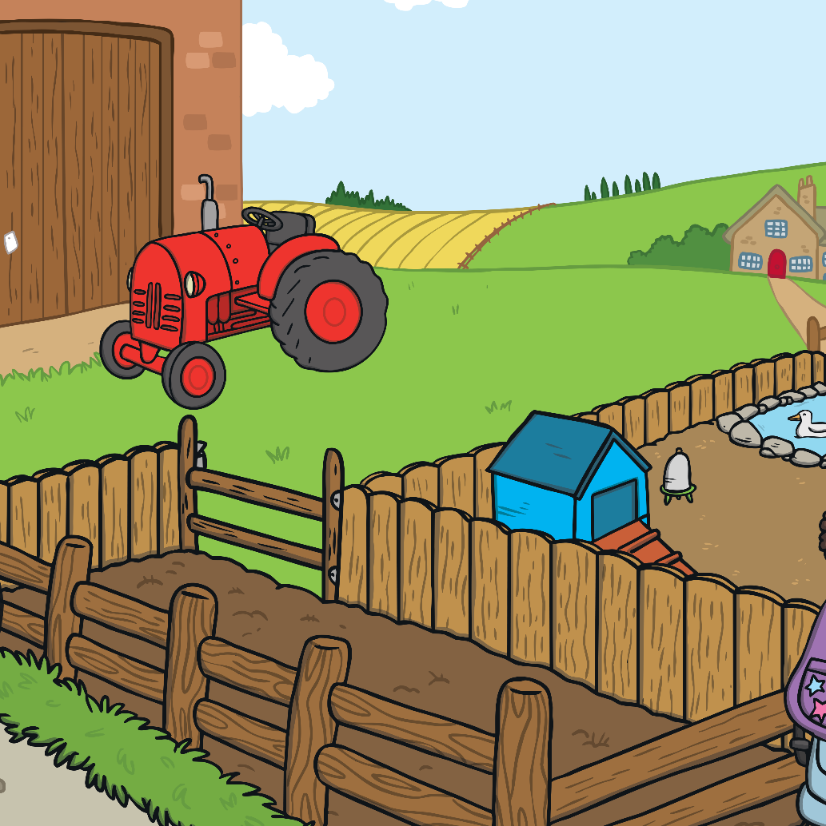
farm
farm
?
Next

Slide 52

harp
harp
?
Next

Slide 53
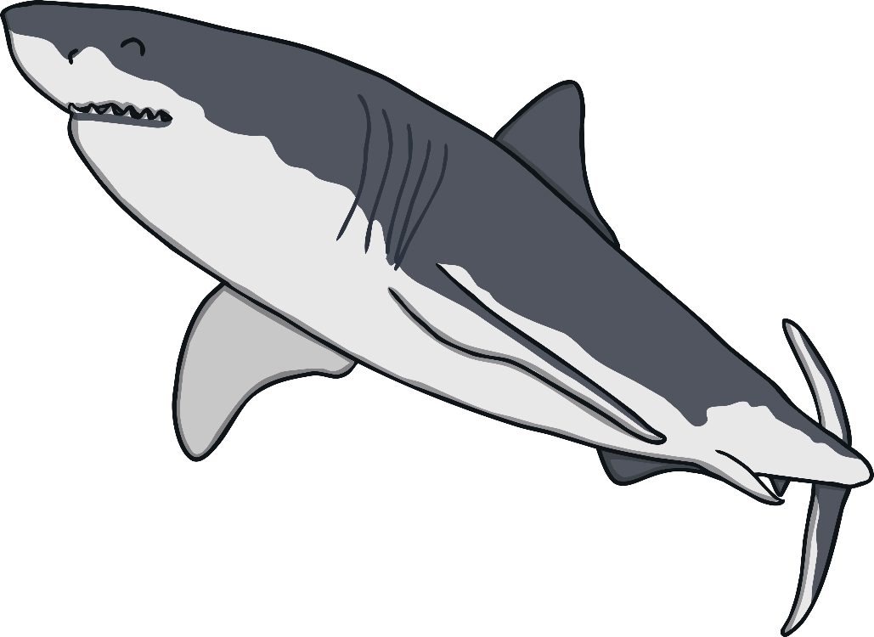
shark
shark
?
Next

Slide 54


horn
horn
?
Next

Slide 55
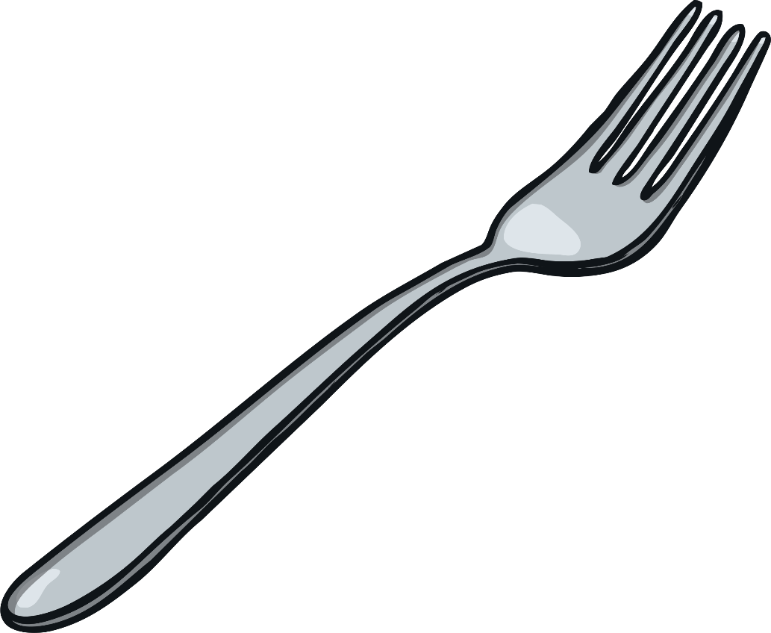
fork
fork
?
Next

Slide 56
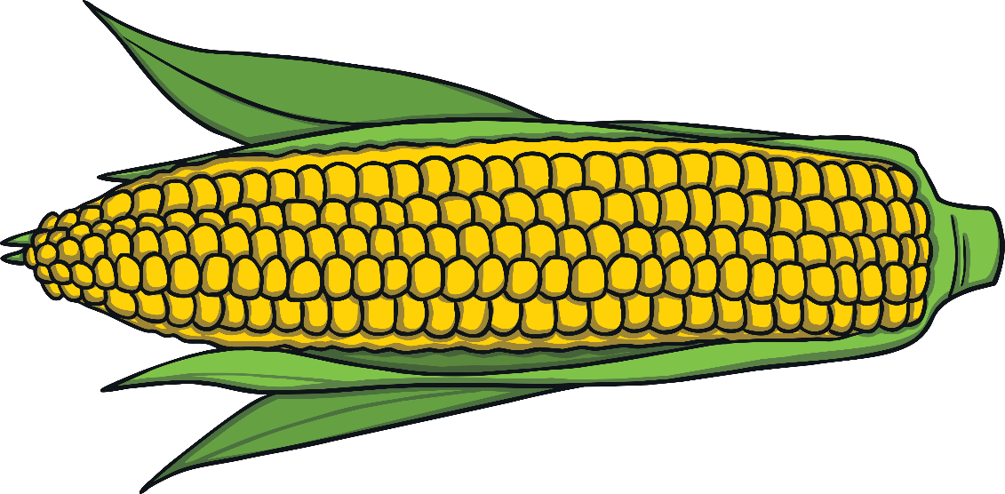
corn
corn
?
Next

Slide 57
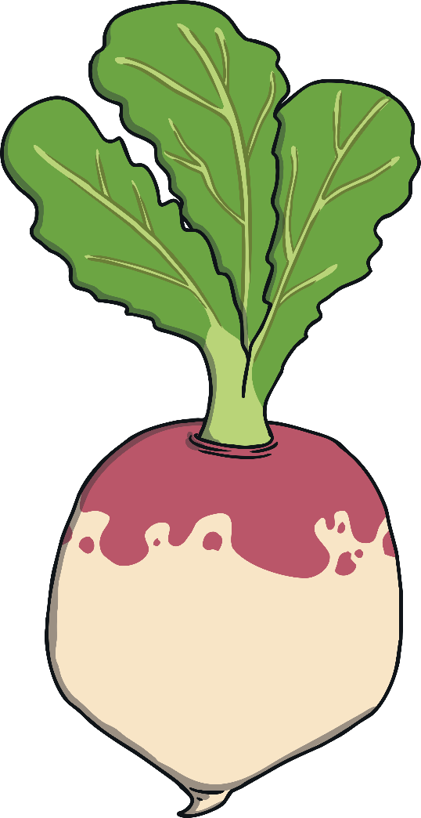
turnip
turnip
?
Next

Slide 58

church
church
?
Next

Slide 59
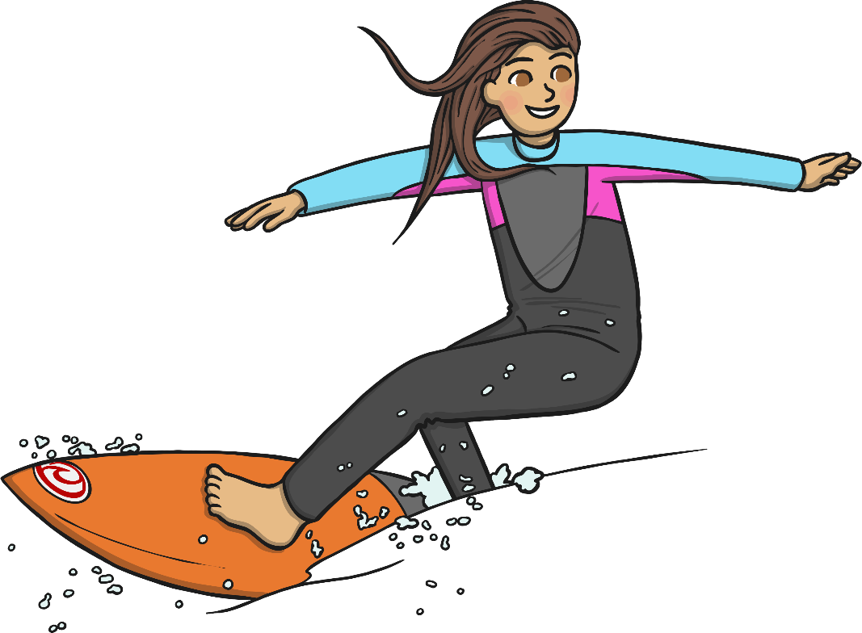
surf
surf
?
Next

Slide 60
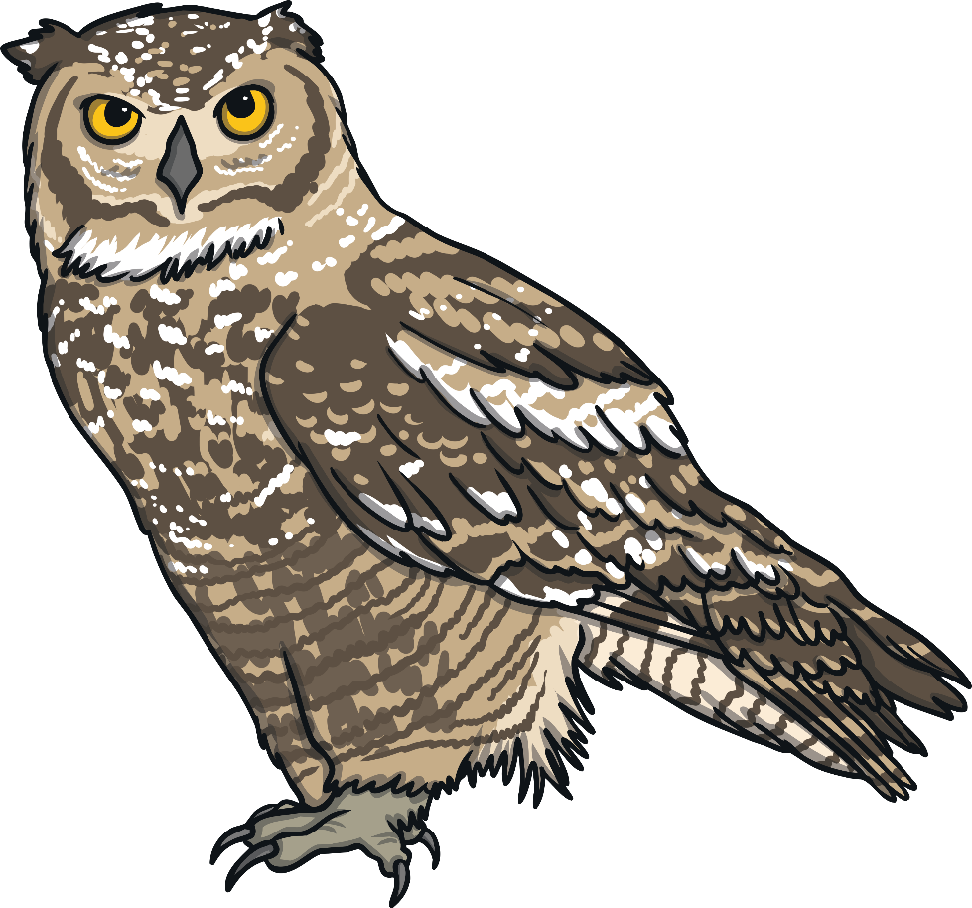
owl
owl
?
Next

Slide 61
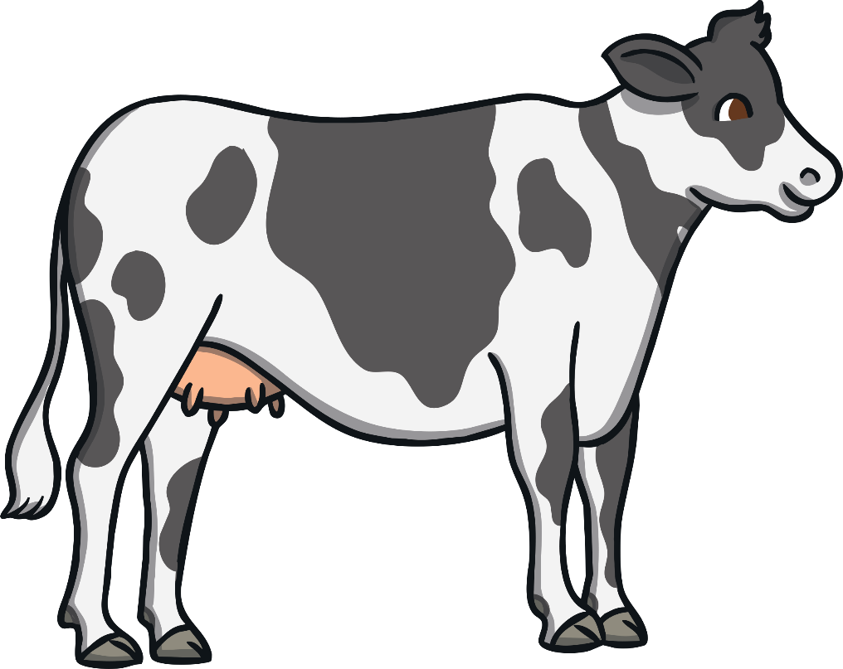
cow
cow
?
Next

Slide 62

down
down
?
Next

Slide 63
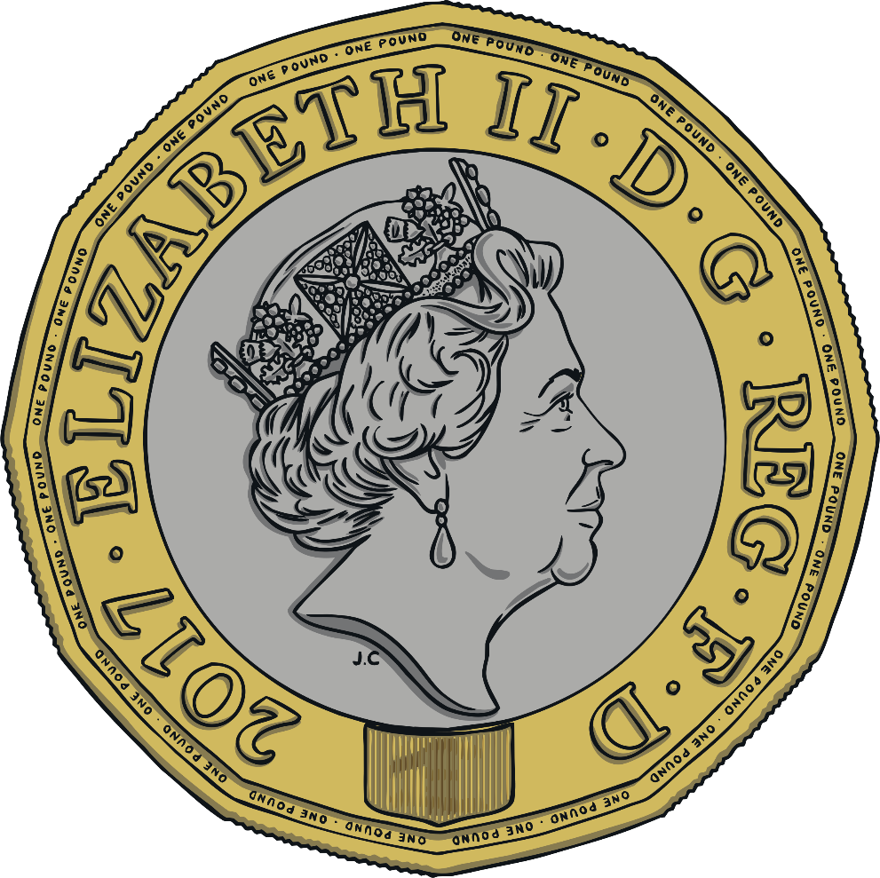
coin
coin
?
Next

Slide 64

foil
foil
?
Next

Slide 65
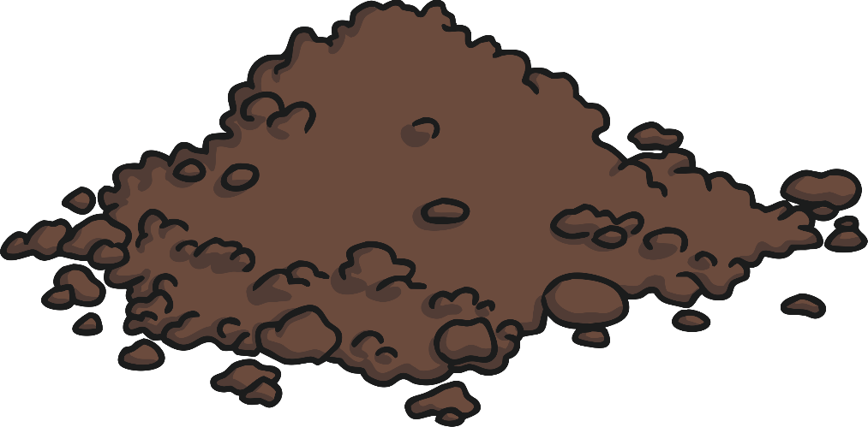
soil
soil
?
Next

Slide 66

beard
beard
?
Next

Slide 67

gear
gear
?
Next

Slide 68

hear
hear
?
Next

Slide 69
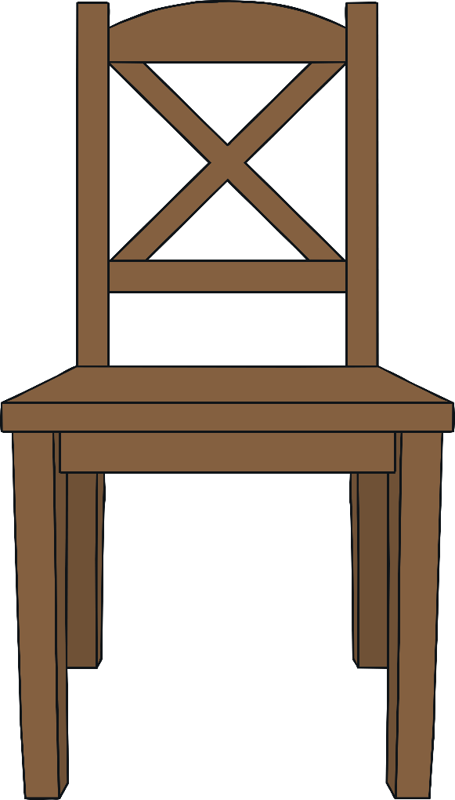
chair
chair
?
Next

Slide 70
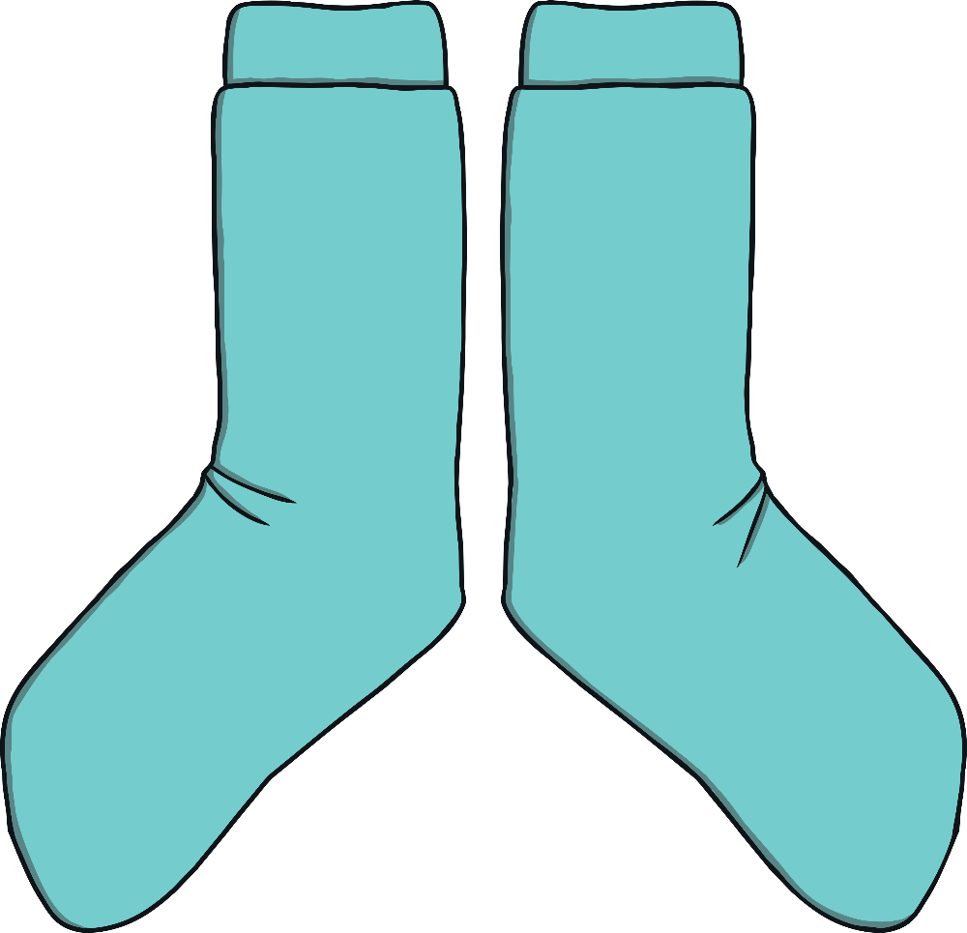
pair
pair
?
Next

Slide 71


hair
hair
?
Next

Slide 72
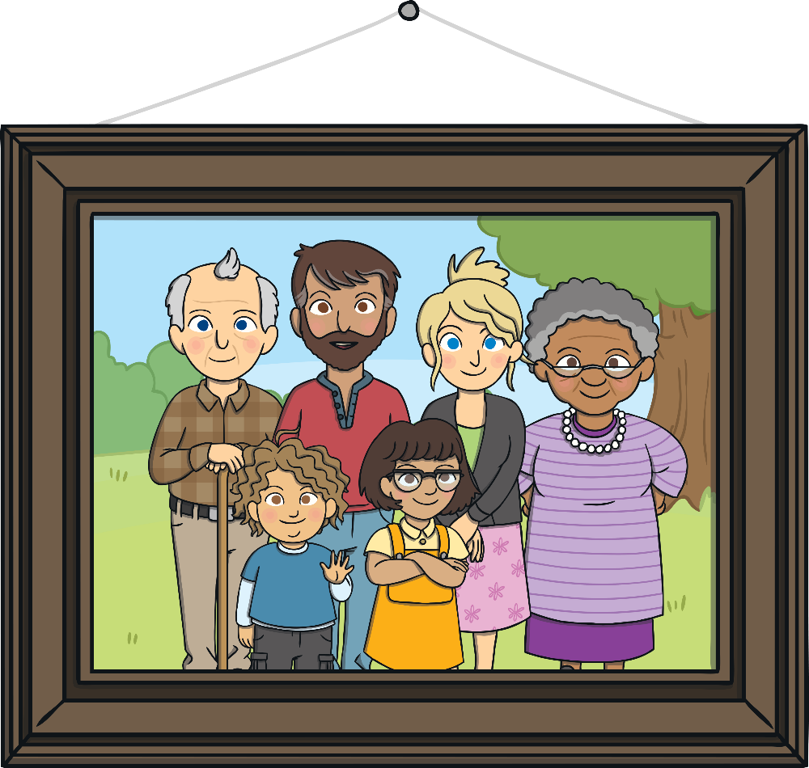
picture
picture
?
Next

Slide 73
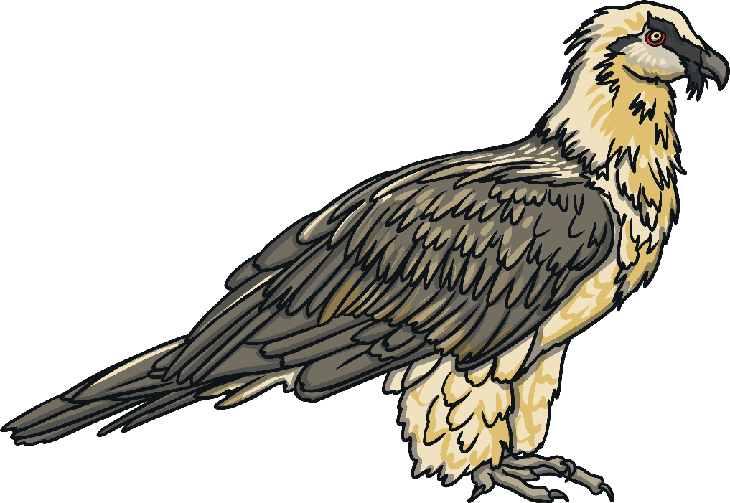
vulture
vulture
?
Next

Slide 74
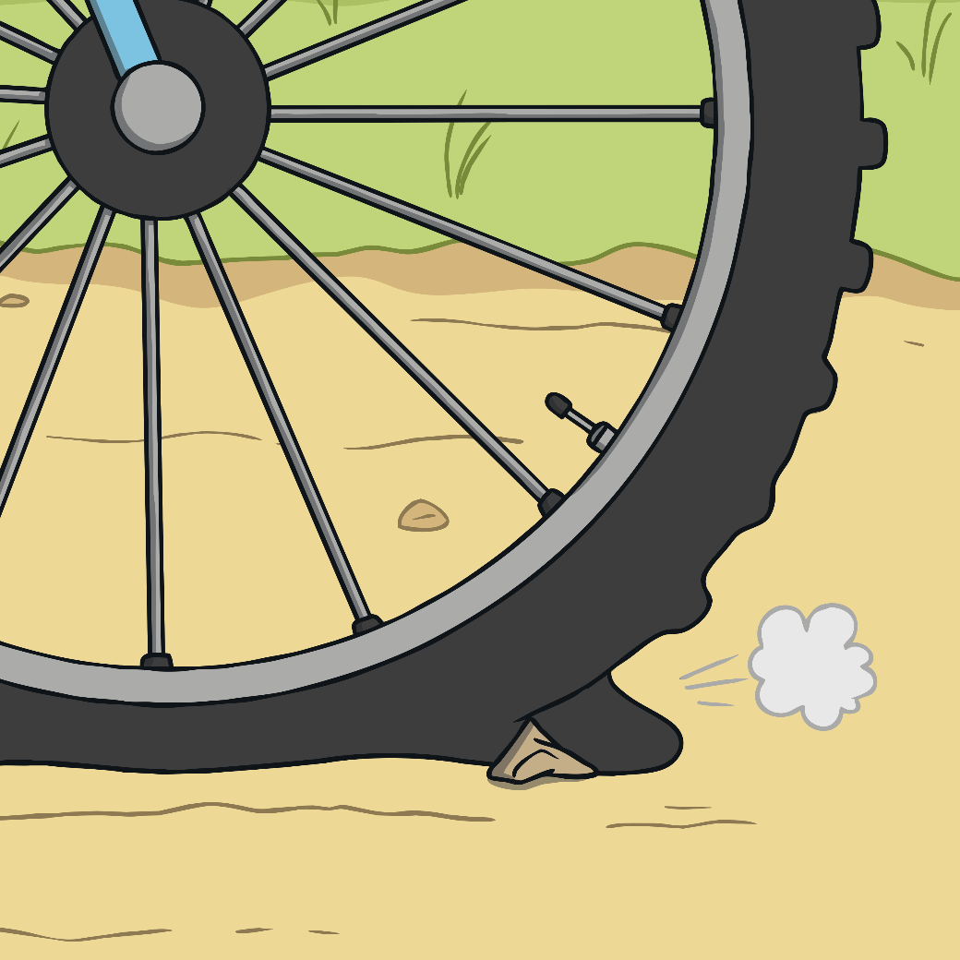
puncture
puncture
?
Next

